Slide 1
School of Computing Science and Engineering
Course Code : BCSE3069 Course Name: Computer Graphics
Introduction
Types of Computer Graphics
Graphics Display
Random Scan Display
Raster Scan Display
Frame Buffer
Video Controller
Name of the Faculty: Ashish Kumar Srivastava Program Name: B.Tech

Slide 2
School of Computing Science and Engineering
Course Code : BCSE3069 Course Name: Computer Graphics
“a picture is worth ten thousand words”
Name of the Faculty: Ashish Kumar Srivastava Program Name: B.Tech

Slide 3
School of Computing Science and Engineering
Course Code : BCSE3069 Course Name: Computer Graphics
Introduction
Why computer graphics?
Fun! Visible!
Everywhere
Visual system offers:
Parallel input
Parallel processing
Computer graphics: ideal for human-computer communication
Name of the Faculty: Ashish Kumar Srivastava Program Name: B.Tech

Slide 4
School of Computing Science and Engineering
Course Code : BCSE3069 Course Name: Computer Graphics
Introduction
What is Computer Graphics?
Sliced by specialty
Imaging = representing 2D images
Modeling = representing 3D objects
Rendering = building 2D images from 3D models
Animation = simulating changes over time
Hardware = computer architecture for graphics
Name of the Faculty: Ashish Kumar Srivastava Program Name: B.Tech

Slide 5
School of Computing Science and Engineering
Course Code : BCSE3069 Course Name: Computer Graphics
Introduction
What is Computer Graphics?
Computer graphics is concerned with the generation, representation, manipulation and display of pictures with the aid of a computer.
The Process transforms and presents information in a visual form.
Image created by computer is called computer graphics.
Name of the Faculty: Ashish Kumar Srivastava Program Name: B.Tech
Notes:
Computer Graphics is an area of computer science and engineering which play a very important role in almost every applications of computer software and use of computer science. Computer Graphics involves display, manipulation and storage of pictures and experimental data for proper visualization using a computer. Typically a graphics system comprises of a host computer which must have a support of a fast processor, a large memory and frame buffer along with a few other crucial components. The first of them is the display devices. Color monitors are one example of such display device. We need a set of input devices. Typical examples are the mouse, keyboard, joystick, touch screen, trackball etc. Through these input devices you provide input to the computer and display device is an output device which shows you the image.There are other examples of output devices like LCD panels, laser printers, color printers, plotters etc. We can have interfacing devices for a computer graphic system such as video input output to a system or an interface to the TV. So these are some of the basic requirements necessary to build a computer graphic system

Slide 6
School of Computing Science and Engineering
Course Code : BCSE3069 Course Name: Computer Graphics
Introduction
What is Computer Graphics?
Computer graphics is concerned with the generation, representation, manipulation and display of pictures with the aid of a computer.
Typical graphics system comprises of a host computer with support of fast processor,large memory, frame buffer and
Display Devices (color monitors)
Input Devices (mouse, keyboard, joystick, trackball, touch screen etc.)
Output Devices (LCD panels, printers, plotters etc)
Name of the Faculty: Ashish Kumar Srivastava Program Name: B.Tech
Notes:
Computer Graphics is an area of computer science and engineering which play a very important role in almost every applications of computer software and use of computer science. Computer Graphics involves display, manipulation and storage of pictures and experimental data for proper visualization using a computer. Typically a graphics system comprises of a host computer which must have a support of a fast processor, a large memory and frame buffer along with a few other crucial components. The first of them is the display devices. Color monitors are one example of such display device. We need a set of input devices. Typical examples are the mouse, keyboard, joystick, touch screen, trackball etc. Through these input devices you provide input to the computer and display device is an output device which shows you the image.There are other examples of output devices like LCD panels, laser printers, color printers, plotters etc. We can have interfacing devices for a computer graphic system such as video input output to a system or an interface to the TV. So these are some of the basic requirements necessary to build a computer graphic system

Slide 7
School of Computing Science and Engineering
Course Code : BCSE3069 Course Name: Computer Graphics
Introduction
What is Computer Graphics?
Typical examples are the mouse, keyboard, joystick, touch screen, trackball etc.
Through these input devices you provide input to the computer and display device is an output device which shows you the image.
Name of the Faculty: Ashish Kumar Srivastava Program Name: B.Tech
Notes:
Computer Graphics is an area of computer science and engineering which play a very important role in almost every applications of computer software and use of computer science. Computer Graphics involves display, manipulation and storage of pictures and experimental data for proper visualization using a computer. Typically a graphics system comprises of a host computer which must have a support of a fast processor, a large memory and frame buffer along with a few other crucial components. The first of them is the display devices. Color monitors are one example of such display device. We need a set of input devices. Typical examples are the mouse, keyboard, joystick, touch screen, trackball etc. Through these input devices you provide input to the computer and display device is an output device which shows you the image.There are other examples of output devices like LCD panels, laser printers, color printers, plotters etc. We can have interfacing devices for a computer graphic system such as video input output to a system or an interface to the TV. So these are some of the basic requirements necessary to build a computer graphic system

Slide 8
School of Computing Science and Engineering
Course Code : BCSE3069 Course Name: Computer Graphics
Introduction
What is Computer Graphics?
There are other examples of output devices like LCD panels, laser printers, color printers, plotters etc.
We can have interfacing devices for a computer graphic system such as video input output to a system or an interface to the TV.
So these are some of the basic requirements necessary to build a computer graphic system
Name of the Faculty: Ashish Kumar Srivastava Program Name: B.Tech
Notes:
Computer Graphics is an area of computer science and engineering which play a very important role in almost every applications of computer software and use of computer science. Computer Graphics involves display, manipulation and storage of pictures and experimental data for proper visualization using a computer. Typically a graphics system comprises of a host computer which must have a support of a fast processor, a large memory and frame buffer along with a few other crucial components. The first of them is the display devices. Color monitors are one example of such display device. We need a set of input devices. Typical examples are the mouse, keyboard, joystick, touch screen, trackball etc. Through these input devices you provide input to the computer and display device is an output device which shows you the image.There are other examples of output devices like LCD panels, laser printers, color printers, plotters etc. We can have interfacing devices for a computer graphic system such as video input output to a system or an interface to the TV. So these are some of the basic requirements necessary to build a computer graphic system

Slide 9
School of Computing Science and Engineering
Course Code : BCSE3069 Course Name: Computer Graphics
Why is Graphics Cool?
Interdisciplinary
Biology, Physics, Math, Psychology, CS, Art
Visual
Interactive
Work can be demoed to technically illiterate friends
Movies
Games
Money
Video games: $11B (2004)
Movies: $8.5B (2001)
Name of the Faculty: Ashish Kumar Srivastava Program Name: B.Tech
Notes:
Computer Graphics is an area of computer science and engineering which play a very important role in almost every applications of computer software and use of computer science. Computer Graphics involves display, manipulation and storage of pictures and experimental data for proper visualization using a computer. Typically a graphics system comprises of a host computer which must have a support of a fast processor, a large memory and frame buffer along with a few other crucial components. The first of them is the display devices. Color monitors are one example of such display device. We need a set of input devices. Typical examples are the mouse, keyboard, joystick, touch screen, trackball etc. Through these input devices you provide input to the computer and display device is an output device which shows you the image.There are other examples of output devices like LCD panels, laser printers, color printers, plotters etc. We can have interfacing devices for a computer graphic system such as video input output to a system or an interface to the TV. So these are some of the basic requirements necessary to build a computer graphic system

Slide 10
School of Computing Science and Engineering
Course Code : BCSE3069 Course Name: Computer Graphics
What is Computer Graphics?
Sliced by task
Creating pictures on a computer
Interacting with those pictures
Drawing those pictures faster
Displaying those pictures bigger, brighter
Simulating physical phenomena
Visualization of complex data
Acquiring real-world geometry
Simulating plants
Video games
Breaking stuff
…
Name of the Faculty: Ashish Kumar Srivastava Program Name: B.Tech

Slide 11
School of Computing Science and Engineering
Course Code : BCSE3069 Course Name: Computer Graphics
Why is Graphics Cool?
Interdisciplinary
Biology, Physics, Math, Psychology, CS, Art
Visual
Interactive
Work can be demoed to technically illiterate friends
Movies
Games
Money
Video games: $11B (2004)
Movies: $8.5B (2001)
Name of the Faculty: Ashish Kumar Srivastava Program Name: B.Tech

Slide 12
School of Computing Science and Engineering
Course Code : BCSE3069 Course Name: Computer Graphics
Types of Computer Graphics
The four major areas of Computer Graphics are:
display of information,
design and modeling ,
simulation and
user interface.
These are the four major areas where people work and also do research in the field of Computer Graphics.
Name of the Faculty: Ashish Kumar Srivastava Program Name: B.Tech

Slide 13
School of Computing Science and Engineering
Course Code : BCSE3069 Course Name: Computer Graphics
Types of Computer Graphics
Computer Graphics system are of two types:
Active Computer Graphics System (the user controls the display with the help of a graphical user interface using an input device)
Passive Computer Graphics System (you do not have any control, you have to watch whatever is shown to you)
In both cases the input to the system is the scene description and the output is a static or animated scene to be displayed.
Name of the Faculty: Ashish Kumar Srivastava Program Name: B.Tech

Slide 14
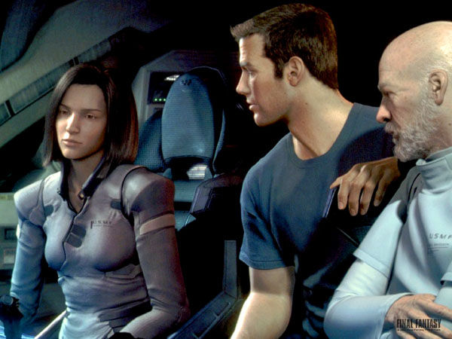
Entertainment (passive)
Final Fantasy (Square, USA)

Slide 15

Entertainment (passive)
A Bug’s Life (Pixar)

Slide 16
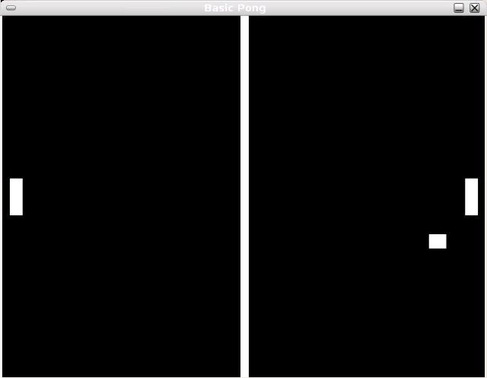
Entertainment (Active)
Pong

Slide 17
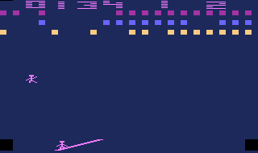
Entertainment (Active)
Circus Atari (Atari)

Slide 18
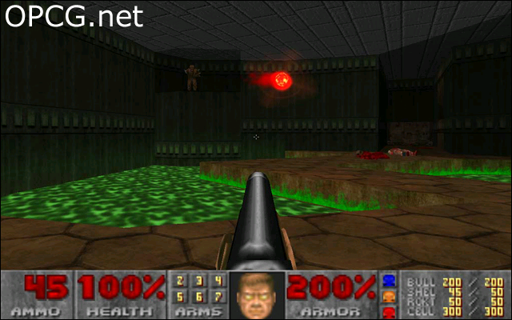
Entertainment (Active)
Doom (ID Software)

Slide 19
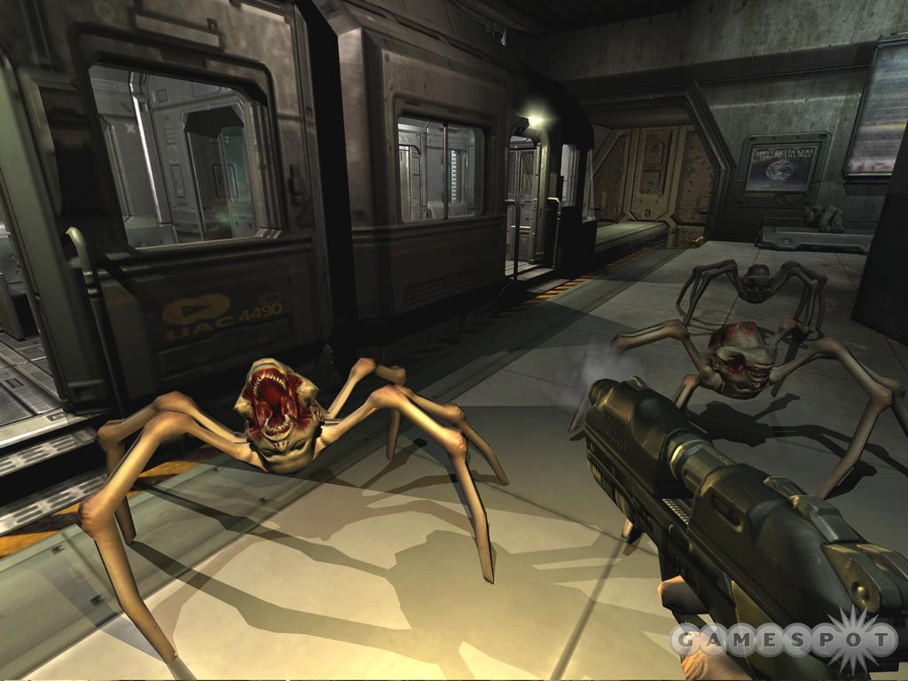
Entertainment (Active)
Doom III (ID Software)

Slide 20
School of Computing Science and Engineering
Course Code : BCSE3069 Course Name: Computer Graphics
Computer Graphics Applications
Computer Graphics may be subdivided into three broad areas:
Generative Graphics
Cognitive Graphics
Image Processing
Name of the Faculty: Ashish Kumar Srivastava Program Name: B.Tech

Slide 21
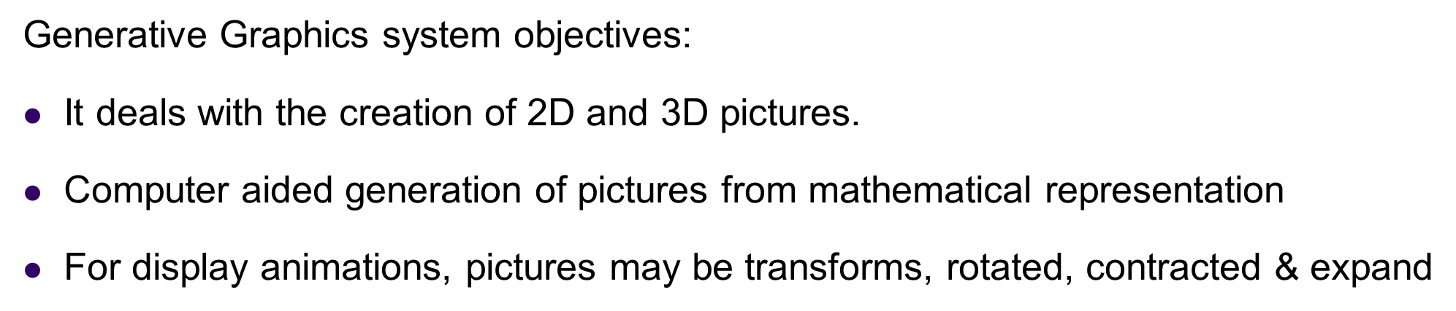
School of Computing Science and Engineering
Course Code : BCSE3069 Course Name: Computer Graphics
Computer Graphics Applications
Generative Graphics
Name of the Faculty: Ashish Kumar Srivastava Program Name: B.Tech

Slide 22
School of Computing Science and Engineering
Course Code : BCSE3069 Course Name: Computer Graphics
Applications Of Generative Graphics
Pilot Training: In pilot training the graphic display may be used to mimic the approach of an aircraft to an airstrip as the pilot manipulates the landing controls.
CAD: Design Electrical, Electronic, Mechanical and Structural components and systems. Design Circuits port layouts, VLSI chips, Aircrafts structures and Buildings structures.
CAM: Manufacturing information (such as parts list etc) are automatically generated. The great advantage of computer graphics is the possibility of very quickly modifying drawings based on drawing changes
Name of the Faculty: Ashish Kumar Srivastava Program Name: B.Tech

Slide 23
School of Computing Science and Engineering
Course Code : BCSE3069 Course Name: Computer Graphics
COGNITIVE GRAPHICS
It deals with algorithms to recognize and classify pictures.
Applications are :
Classify peoples’ faces ,fingerprints is commonly used now a days in criminal investigation.
Microscope pictures of bacterial colonies
ECG patterns and x-rays of different parts of the body to perform medical diagnosis of patient by using computers. etc.
In such applications, the pictures are converted to digital form by devices called optical scanners
The digital information is transformed and classified by specially written pattern recognition programs.
Name of the Faculty: Ashish Kumar Srivastava Program Name: B.Tech

Slide 24
IMAGE PROCESSING GRAPHICS
Image processing apply techniques to modify or interpret existing pictures, such as photographs and TV scans.
It is used to improve and modify the quality of picture.
First image is digitized and there it is given a color pattern for improving color quality.
For example : Boundaries making, if it is not visible.
Two principle uses of image processing are:
Improving picture quality.
Machine perception of visual information as used in robotics.

Slide 25
IMAGE PROCESSING GRAPHICS
Image processing are used to analyze satellite photos of earth and photos of galaxies.
Medical applications also use extensive use of image processing techniques for picture enhancement, in tomography, in simulation of operation.
Image processing has the sub areas like image enhancement, pattern detection and recognition and scene analysis and computer vision.
Application of image processing are: face detection, feature detection, medical image processing, microscope image processing, remote sensing and many others.

Slide 26
Image processing
Image processing applies techniques to modify or interpret existing pictures ,such as photographs and TV scans.
Principle applications of image processing is in following areas
To improve picture quality
To extract information from pictures
To help in m/c perception of visual information e.g. in robotics
To apply image processing , the picture of first digitized into an image file then digital methods are used to rearrange the picture parts, enhance color separation or to improve quality of shading

Slide 27
GUI Interfaces
Graphical User Interface
Typical components used
Menus
Icons
Cursors
Dialog boxes
Scroll bars
Buttons
Valuators
Grids
Sketching( used to draw lines, polylines, arcs, ellipses )

Slide 28
Education and Training
Computer generated model of physical, financial and economic system are useful educational aid.
They find wide use in education and training institution.
Special simulation aids are also made for specialized area for providing training for aircraft pilot, ship captains etc.

Slide 29
Presentation Graphics
Reports can be presented on slides and transparencies.
They can be used to present scientific, mathematical and economic data using different kind of figures, graphics and charts.
3D graphics can also be used to provide special effects and more attractive presentations.

Slide 30
Display Devices
CRT,EGA/CGA/VGA/SVGA monitors, plotters, laser printers, films, flat-panel devices, video digitizers, scanners, LCD panels, keyboard, joystick, mouse, touch screen, track ball etc.
Commonly used display device is the MONITOR or CRT MONITOR

Slide 31
Types of CRT Display Devices
DVST( Direct View Storage Tube)
Calligraphic or Random Scan Display System
Refresh and Raster Scan Display System
Commonality between these three devices is they all are based on
CRT technology

Slide 32
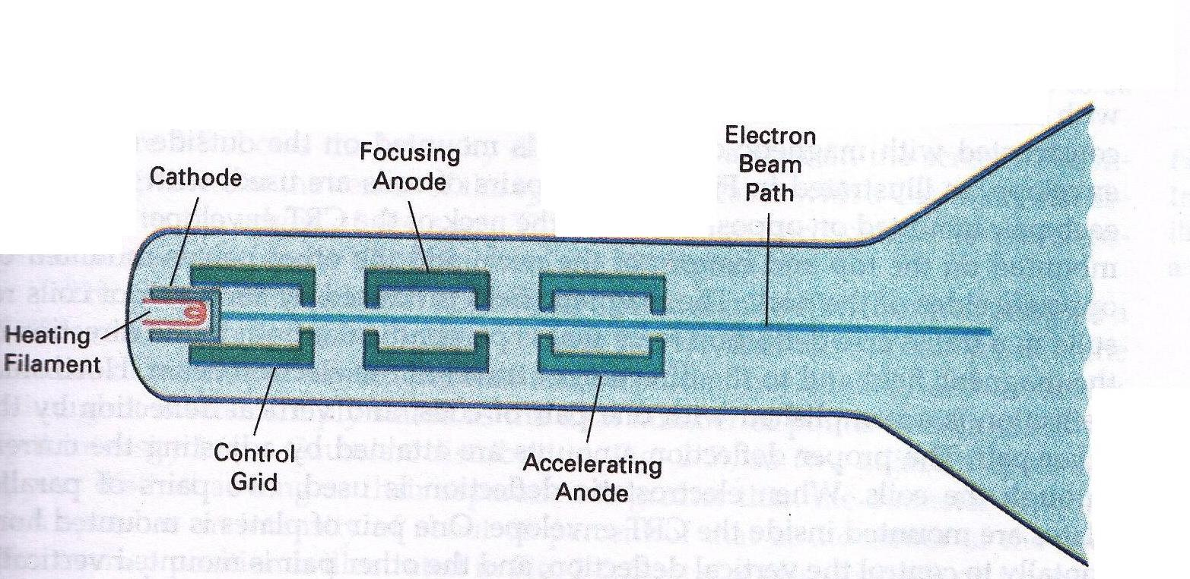
CRT Technology
Operation an electron gun with an accelerating anode

Slide 33

Operation an electron gun with an accelerating anode
In a CRT (Cathode Ray Tube), you have heating filament which is responsible to heat up the cathode element of the CRT that is what generates the electrons or you can say when heating filament heat up the cathode electrons simply boil off from the cathode and these electrons are guided by the set of devices which are cylindrical in nature and helps the electron beam to reach to the screen.
Emitted electron beam must have the following properties:
It must be accurately focused so that it produce the sharp spot of light where it strikes the phosphor.
It must have high velocity since brightness depends on the velocity of the beam.

Slide 34
Operation an electron gun with an accelerating anode
We have three functions
Control Grid
Focusing Anode
Accelerating Anode

Slide 35
What does the control grid do?
When you observe a picture on screen, some parts of the picture may be bright or some picture may be dark.
This brightness or darkness is the illumination or intensity on the screen is basically controlled by the intensity of the beam which strikes the particular point on the screen
This intensity of the screen is controlled by controlling intensity of the electrons or electron beam coming out of the cathode.

Slide 36
What does the control grid do?
Electron beam coming out of the cathode is negatively (-ve) charged.
Control grid is also negatively (-ve) charged. It is a high –ve voltage applied to the control grid
If both are –vely charged so they repel each other.
The amount of voltage at the control grid will essentially allow a certain amount of electrons to pass through the control grid
So, we can say the number of electrons pass through the control grid is controlled by the voltage applied on the control grid.

Slide 37
What does the control grid do?
So, if you reduce the amount of voltage on the control grid , you will allow large number of electrons to pass through the control grid and the intensity of beam will be higher so, the illumination or intensity on the screen will also be higher.
and vice-versa

Slide 38
Focusing Anode & Accelerating Anode ,unlike the control grid these are +vely charged or +ve voltage

Slide 39
Focusing Anode & Accelerating Anode
Focusing Anode
helps us to focus the electron beam on the particular location of the screen
Accelerating Anode
is required to strike the electron beam on to the screen with a very high speed or velocity to emit light.

Slide 40
Till now you can see the electron beam is going straight and will be able to hit the centre of the screen
But the screen is the rectangular matrix.
To create a picture, this beam should move all over the screen.
So, you need horizontal deflection as well as vertical deflection so that you can cover the entire screen.

Slide 41
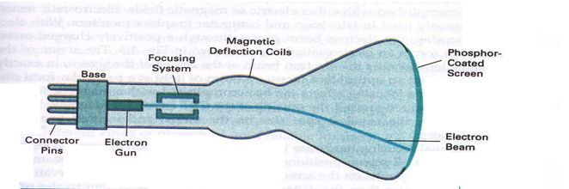
Basic Design of Magnetic Deflection CRT

Slide 42
Magnetic Deflection
This beam is deflected by magnetic deflection coils which is available on the top and bottom and also on other side of the CRT
Magnetic deflection coils generates the magnetic field which deviate the electron beam.

Slide 43
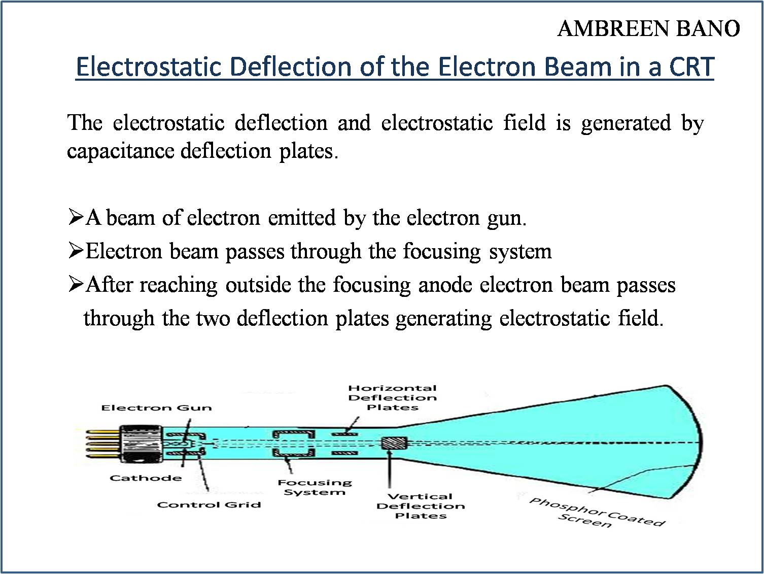

Slide 44
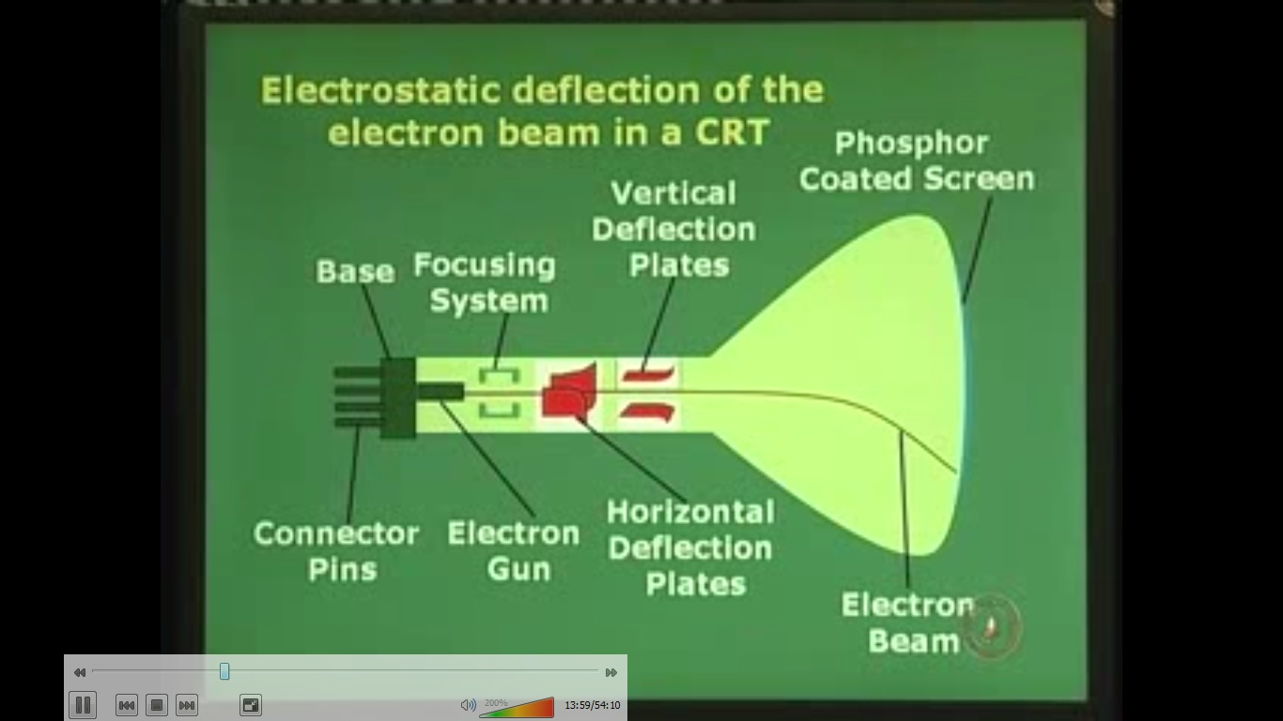

Slide 45
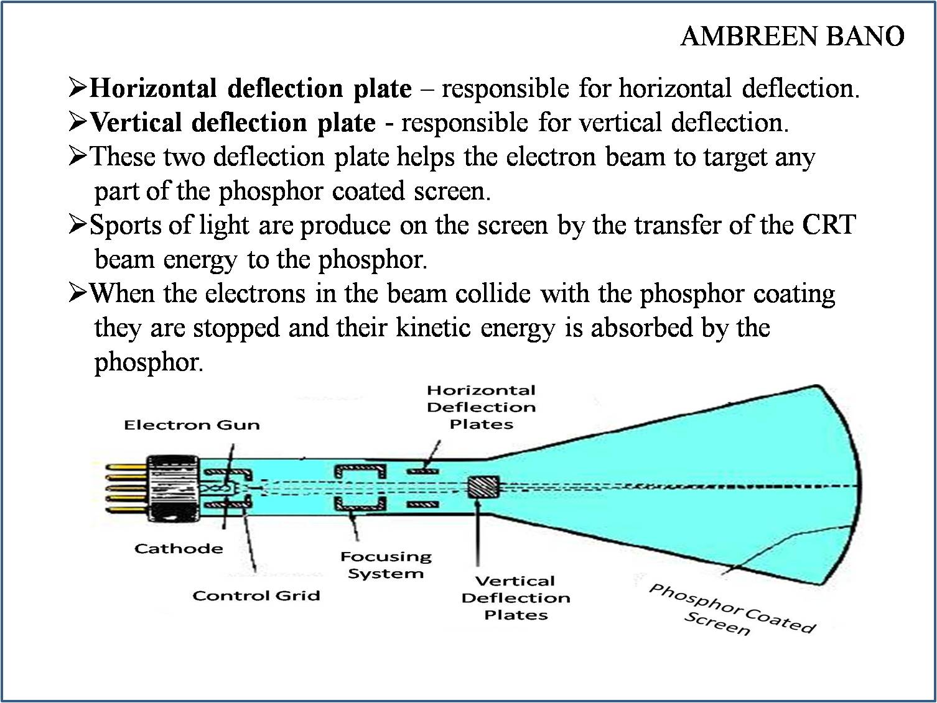

Slide 46
NOTE: The voltages used for deflection are generated by the display controller from digital values provided by the computer. These values normally represent co-ordinates that are converted into voltages by digital-to-analog converter

Slide 47
Oscilloscope (CRO) uses capacitive deflection plates TV system uses electromagnetic deflection system

Slide 48
Basic Operation
The beam of electrons emitted by an electron gun passes through focusing and deflection system that directs the beam toward specified positions on the phosphor coated screen
The phosphor glows when electron beam strikes it.
Because light emitted by the phosphor fades very rapidly, a steady picture is maintained by tracing it out repeatedly .This is called refreshing

Slide 49
Refreshing Redraw the picture repeatedly by quickly directing the electron beam back over the same points. This is called refreshing

Slide 50
Properties of phosphor

Slide 51
Properties of phosphor
Persistence:-it is defined as time taken for brightness to drop to 1/10th of its initial value that means how long they continue to emit light.
Or, It is defined as the time from the removal of excitation to the moment when phosphorescence has decayed to 10 % of the initial light output.
E.g. most phosphors used in graphics equipment it is usually 10 to 60 microseconds.
A phosphor with low persistence is useful for animation.
A phosphor with high persistence is useful for displaying highly complex, static pictures

Slide 52
Properties of phosphor
Color:-phosphors are generally available in blue, green & white colors.
Grain size:-grain size is the size of pixels
e.g. if grain size is small pixel will be more. To produce higher resolution grain size must be small.
Efficiency:-it is defined as the amount of electrical energy converted into light energy in which some energy is lost as heat.
Resistance:- To burning under long excitation is an important property of phosphor

Slide 53
Note: Any given phosphor has several different quantum levels to which electrons can be excited, each corresponding to a color associated with the return to an unexcited state.
Further , electrons on some levels are less stable and return to unexcited state more rapidly than others.

Slide 54
PHOSPHORENCE
Phosphorescence is the light given off by the return of relatively more stable(elements that have full outer shell) excited electrons to their unexcited state once the electron beam excitation is removed.
With typical phosphors, most of the light emitted is phosphorescence.
It is a specific type of photoluminescence related to fluorescence.
A phosphorescent material does not immediately re-emit the radiation it absorbs.
Notes:
O flou
54

Slide 55
FLUORESCENCE
A phosphor’s fluorescence is the light emitted as these very unstable electrons lose their excess energy while the phosphor is being struck by electrons.
Fluorescence occurs where the energy is supplied by electromagnetic radiation, usually ultraviolet light. The energy kicks an electron of an atom from a lower energy state into an “excited” higher energy state, then the electron releases energy in the form of light when it falls back to a lower energy state.

Slide 56
Refresh Rate
Refresh rate of a CRT is the number of times per second the image is redrawn.
It is typically 60 per second for raster displays.
Refresh rate to avoid flickering – 60 Hz.
A flicker free picture appears constant or steady to the viewer.
Reducing the refresh rate increases flicker
As the refresh rate decreases, flicker develops because the eye can no longer integrate the individual light impulses coming from a pixel.

Slide 57
Critical Fusion Frequency
The refresh rate above which a picture stops flickering and fuses into a steady image is called Critical Fusion Frequency (CFF).
Very high intensity images requires refresh rate of 80 to 90 Hz.

Slide 58
Note: Refresh rate of raster scan display is usually at least 60 frames per second and is independent of picture complexity
Refresh rate of vector systems depends directly on the picture complexity (no. of lines ,points and characters)
Greater the complexity, longer the time taken by a single refresh cycle and lower the refresh rate.

Slide 59
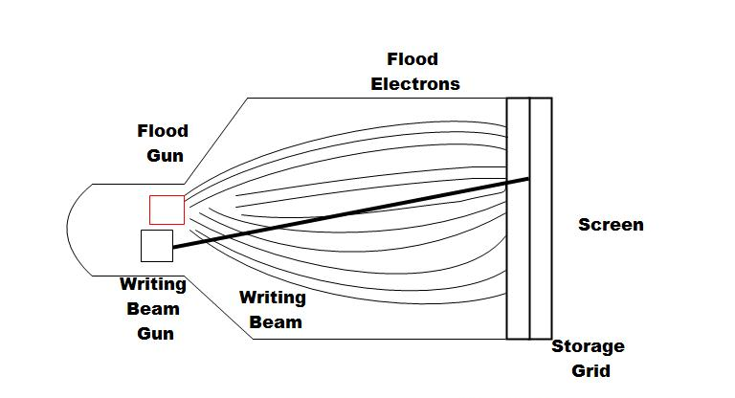
DVST
Collector

Slide 60
DVST
The DVST behaves like a CRT with long persistence.
A line remains visible for up to an hour before it starts to fade.
The primary gun is used to store the picture pattern
Flood gun maintains the picture display.
The writing beam does not write directly on the phosphor but a fine mesh wire grid coated with dielectric( electrical insulator)
A pattern of +ve charges is deposited on the grid
A continuous flood of electrons is emitted by the electron gun.
These flood electron transfers the pattern of charges from the grid to the phosphor.
Just behind the storage mesh is a second grid which is called a collector which makes the flow of flood electrons smooth.
Where there is +ve charge on the mesh the electrons are attracted and pass through it to strike the phosphor.

Slide 61
Advantages
It offers the flat screen
It is a CRT with long persistence phosphor
It provides flicker free display
No refreshing is necessary

Slide 62
Limitations
Very limited interactive support
Modifying any part of the image requires redrawing the entire image. So, animation is ruled out in case of DVST.
Change in the image requires to generate a new charge distribution in the DVST
Slow processing of drawing-(typically a few seconds are necessary for a complex picture)
Erasing takes about 0.5 seconds .Selected parts of the picture can't be erased. All lines and characters must be erased.
Only single intensity is possible. The DVST can’t display multiple colors.

Slide 63
RASTER SCAN DISPLAY

Slide 64
Raster Scan Display
Used in television screens
Unlike DVST and random scan display which were line drawing ,refresh CRT is point- plotting device.
Raster displays stores the display primitives (lines, characters, shaded & patterned areas) in refresh buffer.
The image is displayed on the screen as a succession of scan lines where each scan line is made up of several pixels.
The picture definition is stored in the memory are called the Refresh Buffer or Frame Buffer as rectangular matrix containing intensity value for each dot or pixel on the screen.
Or, you can say the refresh buffer stores the drawing primitives in terms of points and pixel components.

Slide 65
Raster Scan Display
As the electron beam moves across each row, the beam intensity is turned on or off depending on the value of each pixel.
In a simple black and white system , each screen point is either on or off i.e. only one pixel is needed.
For complex systems displaying several colors, additional bits are required i.e. high color quality system use 24 bits per pixel.
Frame buffer which uses one bit per pixel is called bitmap
Frame buffer which uses multiple bits per pixel is called pix-map
Entire image is scanned out sequentially by the video controller( one raster line at a time)
Raster lines are scanned from top to bottom and then back to top
Causes the effect of jaggies or staircase effects
It is suitable for realistic display of scenes containing different color patterns and shading.

Slide 66
HORIZONTAL RETRACE & VERTICAL RETRACE
At the end of each scan line, the electron beam returns to the left side of the screen to begin displaying the next scan line. The return to the left of the screen, after refreshing each scan line is called the horizontal retrace.
And at the end of each frame, the electron beam returns to the top left corner of the screen to begin the next frame is called the vertical retrace

Slide 67
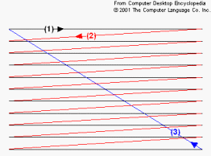
Fig. shows horizontal and vertical retrace
Starting at the top-left of the screen and going to the bottom-right, the electron beam is turned on a line at a time (1), then turned off to go back to the next line (2), then off once again to go back up to the top (3).

Slide 68
Raster scan display system draws a discrete set of points

Slide 69
CPU
Peripherals
System bus
System memory
Video controller
CRT
Architecture of a Simple Raster Graphics System

Slide 70
CPU
Peripherals
System bus
System memory
Frame buffer
Video controller
CRT
Architecture of a Simple Raster Graphics System with a fixed portion
of the system memory reserved for the frame buffer

Slide 71

Raster Scan
Generator
Scan Conversion horizontal/vertical deflection
Y-Register
X-Register
CRT
Memory Address
Pixel value(s)
Intensity
DATA
MEMORY
Logical Organization of the video controller

Slide 72
Logical Organization of the video controller
Assume that the frame buffer is addressed in x 0 to xmax and in y from 0 to ymax.
Then ,at the start of a refresh cycle, the X register is set to zero and Y register is set to ymax (the top scan line).
As the first scan line is generated, the X address is incremented up through xmax.
Each pixel value is fetched and is used to control the intensity of the CRT beam.
After the first scan line, the X address is reset to zero and the Y address is decremented by one.
The process continues until the last scan line (y=0) is generated

Slide 73
ARCHITECTURE OF RASTER SCAN DISPLAY (WITH DISPLAY PROCESSOR)

Slide 74
PERIPHERAL DEVICE
CPU
DISPLAY
PROCESSOR
SYSTEM MEMORY
DISPLAY
PROCESSOR
MEMORY
FRAME
BUFFER
VIDEO CONTROLLER
CRT

Slide 75
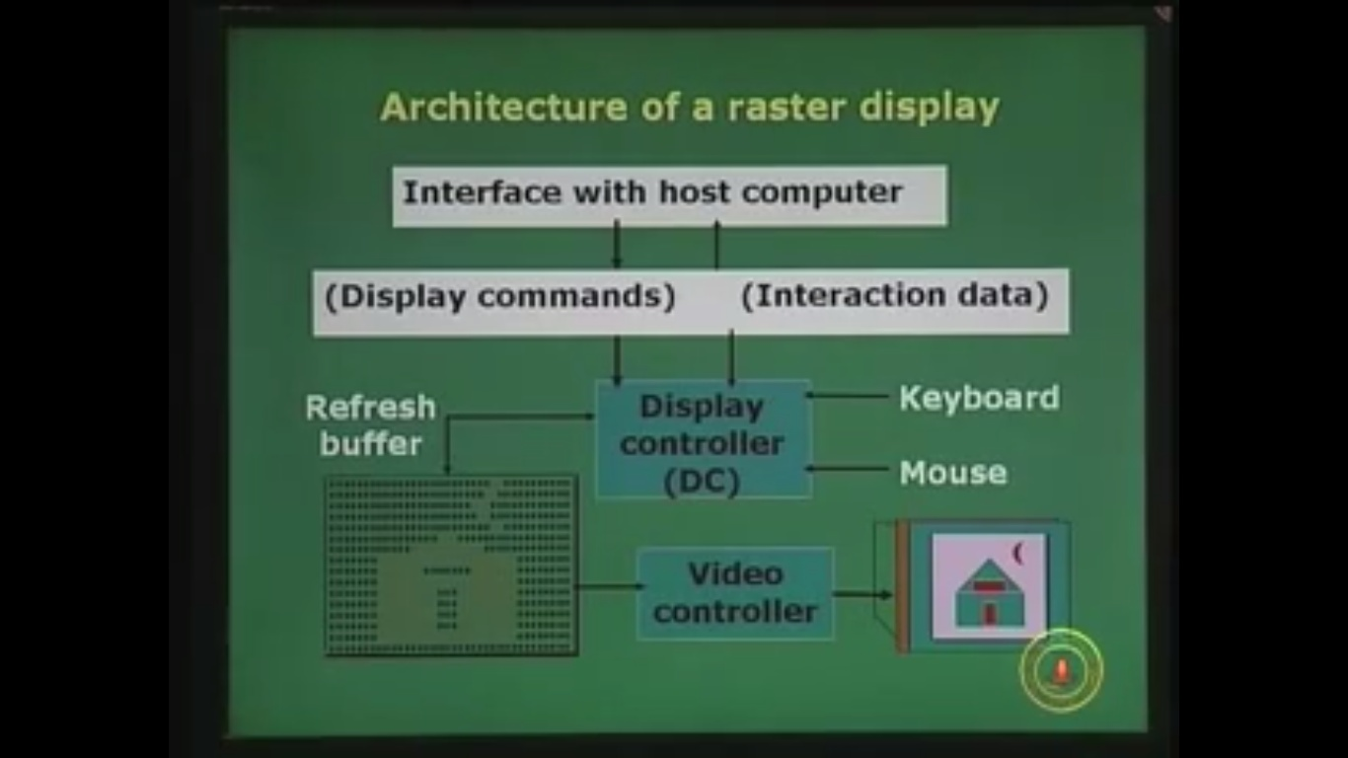

Slide 76
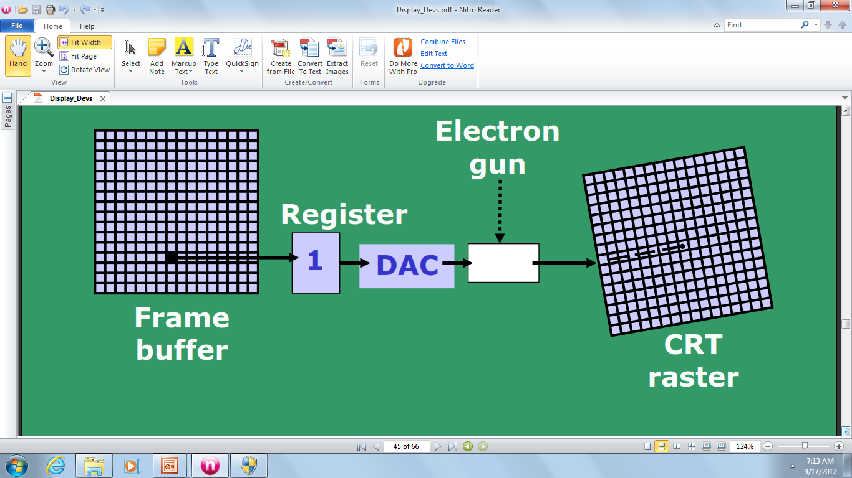
A single bit-plane black & white frame buffer raster CRT graphics device.

Slide 77
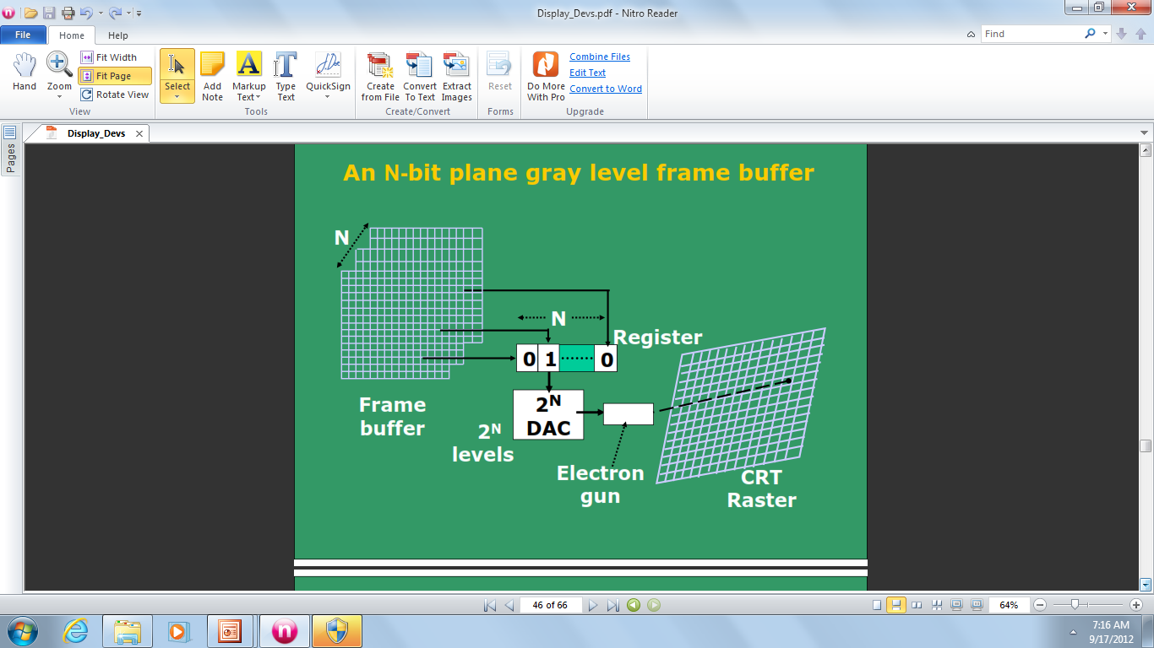
An N-bit plane gray level frame buffer

Slide 78
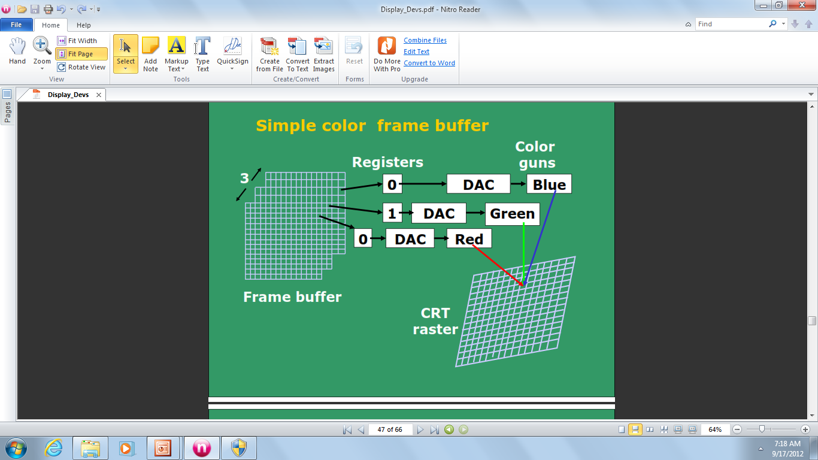
Simple color frame buffer

Slide 79
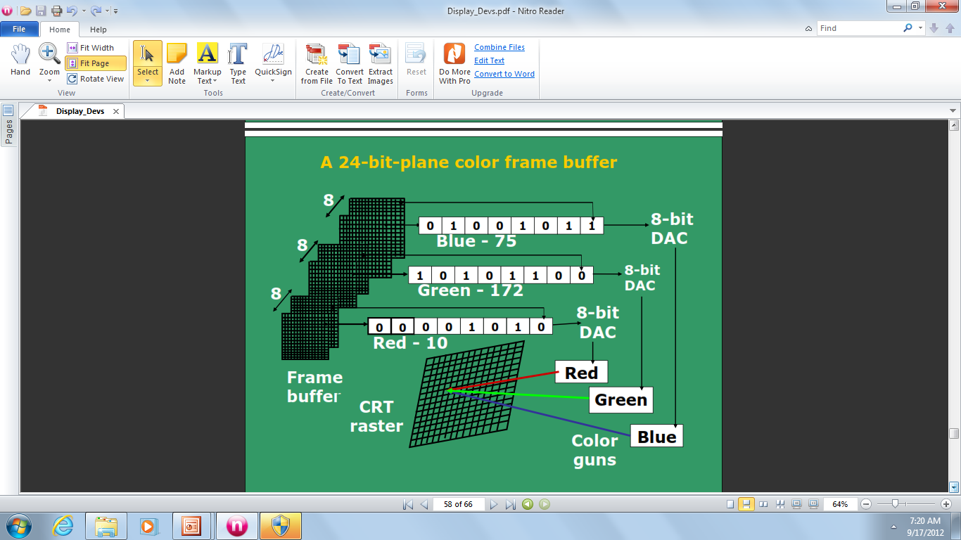
A 24-bit-plane color frame buffer

Slide 80
Memory Usage
If one uses a 512ˣ512 element, then 2¹⁸ bits are necessary in a single bit plane.
Memory size required = 32 KB
A DAC (digital to analog converter) is used to convert the bit value (0,1) to analog signals for refreshing the screen

Slide 81
Memory Size Required for N-bit plane
N | Display Color | Memory Size
1 | Black & White | 128KB
8 | 256 | 1MB
24 | 16 million colors | 3MB
32 | 16 million colors | 4MB
If one uses 1024ˣ1024 high resolution CRT

Slide 82
Random Scan Display
Also called vector, stroke, line drawing displays.
Characters are also made of sequences of strokes (or short lines).
Vectored-because electron beam is deflected from end point( vector type of movement )
In random scan display the electron beam is directed only to those parts of screen where picture is to be drawn.
Order of deflection is dictated by the arbitrary order of the display commands.
The picture is drawn one line at a time and therefore these monitors are also called as “Vector Displays”.
The picture definition is stored as a set of line drawing commands in an area of memory called as “Refresh Buffer” or “Refresh Display File”.
To display a specified picture the system cycles through a set of commands stored in a display file.
After all commands are processed , the system cycle back to the first line command to refresh cycle.
Refresh rate is 30-60times/sec.
It is suitable for line drawing applications but can’t display realistic shaded pictures or scenes.

Slide 83
Block Diagram of Calligraphic Refresh Display
Host CPU
Display Buffer
Display
Controller
CRT
Vector
Generator
Display
Processor

Slide 84
The display processor sends digital and point co-ordinate values to vector generator.
Vector generator needs the co-ordinate values as well as the intensity value to draw any object.
The vector generator converts the digital co-ordinates values to analog voltages for the beam deflection circuits.
Scope of animation is available.

Slide 85
Images
An image is a spatial representation of an object, a two dimensional or three dimensional scene or another image.
In computer graphics ,an image is always a digital image
When we generate with the help of computer graphics then two types of images are available:-
BITMAP IMAGES
VECTOR IMAGES

Slide 86
Bitmap Images
Bitmaps are an image type most appropriate for photo-realistic images and complex drawings require fine details.
A bitmap image is simple information matrix describing the individual dots of an image called pixels.
The bit-depth determines the number of colors that can be displayed by an individual pixel.
We can grab a bitmap image from a screen, scan it with a scanner , download it from a website, or capture it from a video capture device.
Limitations:
Large file sizes
Inabilty to scale or resize the image easily while maintaining quality.

Slide 87
Vector Images
Vector images are most appropriate for lines ,boxes, circles, polygons and other graphic shapes that can be mathematically expressed in angles, co-ordinates and distances.
A vector images can be filled with color and patterns and we can select it as a single object.
Vector drawn objects use a fraction of memory space required to describe and store the same object in bitmap form.
For the web, pages that use the vector graphics use plug-ins such as Flash, and download faster when used for animation draw faster than bitmaps.
Most drawing programs can export a vector drawing as a bitmap but converting bitmap to vector drawn object is difficult.
Limitations:
Vector images cannot be used for photo-realistic images.
Plug-ins are required.

Slide 88
WHY DO WE NEED STANDARDS ?

Slide 89
There is a need of certain set of rules, constraints, syntax, procedures and function calls to built a Graphics Package System.
If there are no standards, then everyone will come up with his/her own standards.
So there is a need to define standards , if not defined then, we will not be able to understand one’s software or graphical package.
Certain Compilers provide their own graphical libraries such as Visual Basic, C, C++, Java, Turbo C, Visual C etc.

Slide 90
These systems can be DEVICE DEPENDENT and DEVICE INDEPENDENT.
Device Dependent- Assembly language and Solaris.
Device Independent- Open- GL, PHIGS.
Standard Graphics Packages are-
GKS (Graphics Kernel system).
first ISO standard low level computer graphics for 2D vector graphics
Applications written to use GKS portable to many platforms and devices
Suitable for chart drawings

Slide 91
SRGP (Simple Raster Graphics Package).
PHIGS (Programmers’ Hierarchical Interactive Graphics system).
Standard for rendering 3D computer graphics,support features like transformations, texture mapping, shading, light models
OPEN-GL-is currently used.

Slide 92
Computer Graphics system could be active or passive
In both cases ,the input to the system is scene description and output is a static or animated scene to be displayed
In case of active system the user controls the display with the help of GUI, using an input device

Slide 93
COLOR CRT MONITORS
Colored pictures can be displayed using a combination of phosphors that emit different color light.
Commonly used techniques for display of colors are:
-> Beam Penetration
-> Shadow Mask

Slide 94
BEAM PENETRATION
Uses multilayer phosphor.
Used with random scan display.
Two layers of phosphor (usually red and green) are coated on inner side of CRT screen.

Slide 95
Electron Beam intensity decides the displayed color.
High potential electron beam excite the green phosphor.
Low potential electron beam excite red phosphor.
Intermediate beam gives combinations of green and red light i.e. orange and yellow.

Slide 96
ADVANTAGE
Inexpensive Method.
DISADVANTAGES
Limited colors are possible.
Poor picture quality.
Difficulty in changing electron beam potential by large amount.

Slide 97
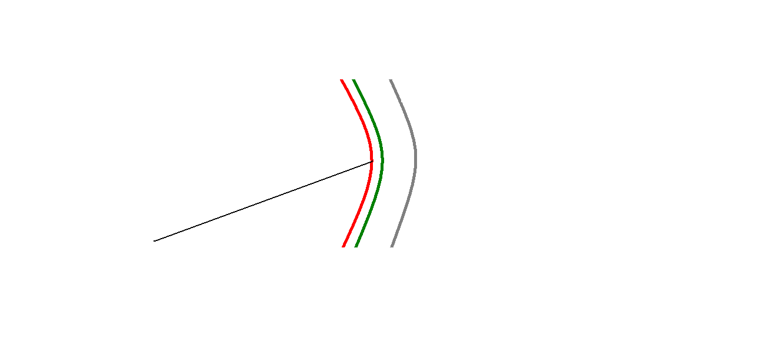
EXCITES RED PHOSPHER
SCREEN
GREEN PHOSPHER
RED PHOSPHER
ELECTRON BEAM

Slide 98
Shadow Mask
Shadow mask method is used in majority of color TV set and computer monitors.
It can display wide range of colors.
This method is commonly used in raster scan displays.
Construction:
It has red, green & blue color dots at each pixel position on the screen (forms a delta)
It also has three electron guns one for each color dot (forms a delta)
A shadow-mask grid is placed just behind the phosphor-coated screen with holes, corresponding to each pixel on screen.

Slide 99
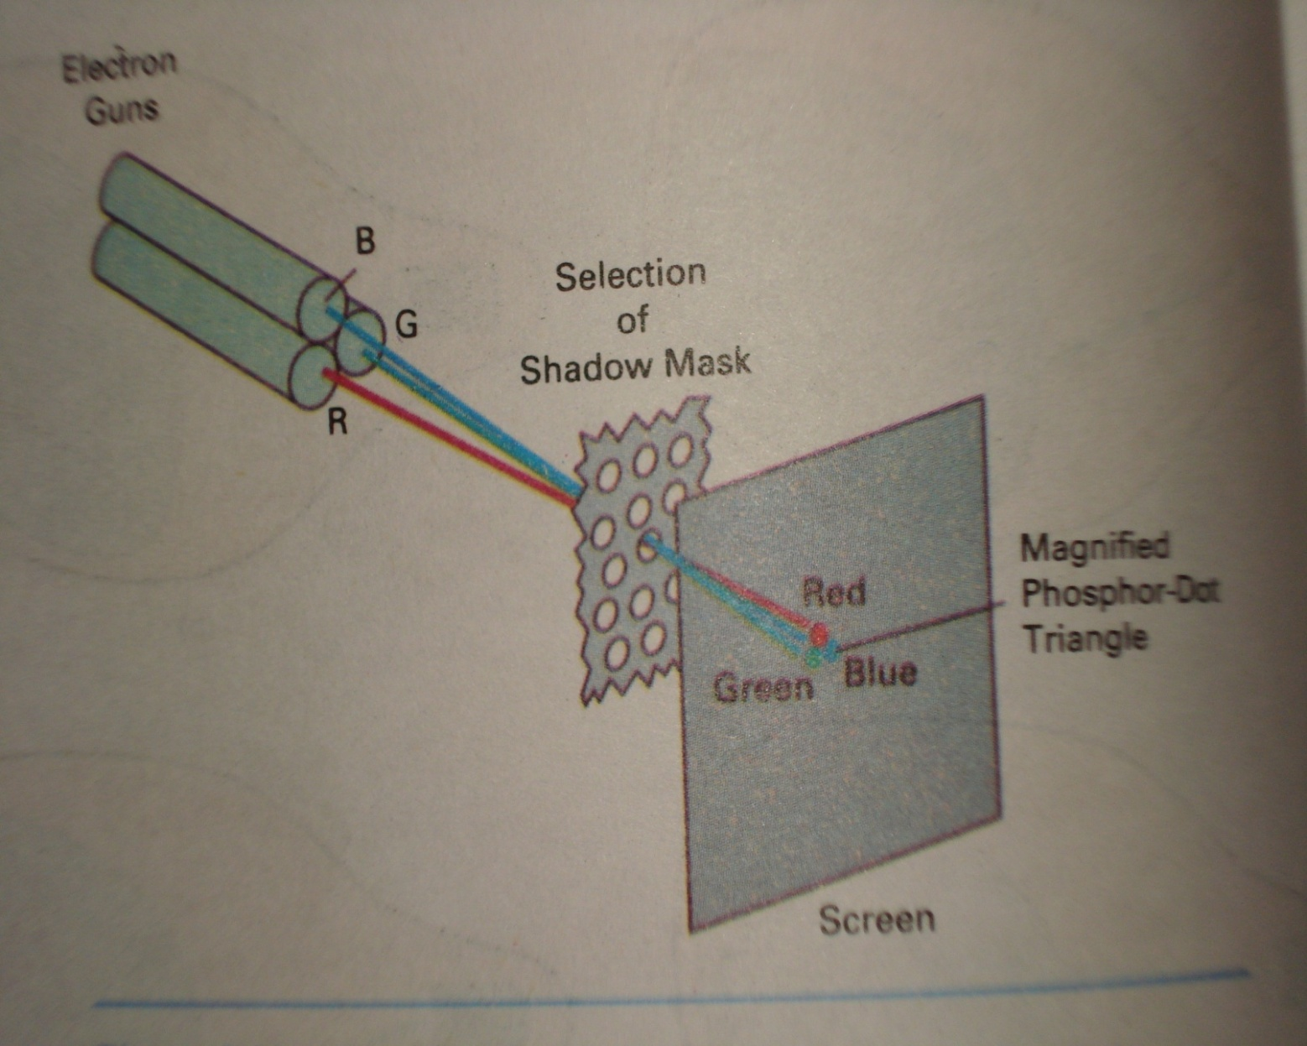

Slide 100
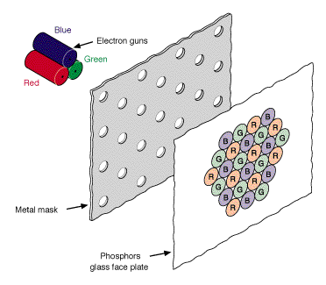

Slide 101
Shadow Mask
A metal plate or shadow mask is placed just behind the phosphor screen.
The plate has small holes.
The guns placed shape of a triangle.
These electron guns group in delta
They are responsible for RED, BLUE & GREEN components of light i.e. output of the CRT.
The electron beam from all the three guns are brought to the same point of focus on the shadow mask
The phosphor is laid down in groups of three spots red ,blue and green such that each spot is struck by electrons from appropriate gun.

Slide 102
By modulating the beam current the light output in each of the three color components can be controlled
Different phosphor light can be combined to get a range of colors

Slide 103
Advantage:
produce realistic images
also produced different colors
and shadows scenes.
Disadvantages
low resolution
expensive
electron beam directed to whole screen

Slide 104
Inherent Memory Devices
To avoid repeated refreshing, inherent memory contents are used.
These devices store picture information inside the CRT.
There are three types of inherent memory devices
DVST
Plasma Panel display
Laser Scan Display

Slide 105
Flat Panel Displays
Less volume, weight and power requirement
Used in flat and thin TV monitors , laptops, calculators ,handheld devices, advertising boards and notice boards etc.
Flat panel displays comes in two categories:
Emissive Displays: They convert electrical energy into light energy. E.g. Plasma Panel Display.
Non Emissive Displays: They use optical effects to convert sunlight or light from other sources into graphical patterns. E.g. Liquid Crystal Display

Slide 106
Electroluminescent Display
Electroluminescent display is an example of emissive displays.
It consists of two glass sheets placed very close to each other.
A series of vertical electrodes are attached on inner glass sheet and horizontally on other sheet.
Electroluminescent substances are a kind of phosphor. Electroluminescent phosphors emit light after absorbing electricity.
The region between glass plates is filled with phosphor such as-:
Phosphor doped with manganese.
Zinc sulphide doped with manganese.

Slide 107
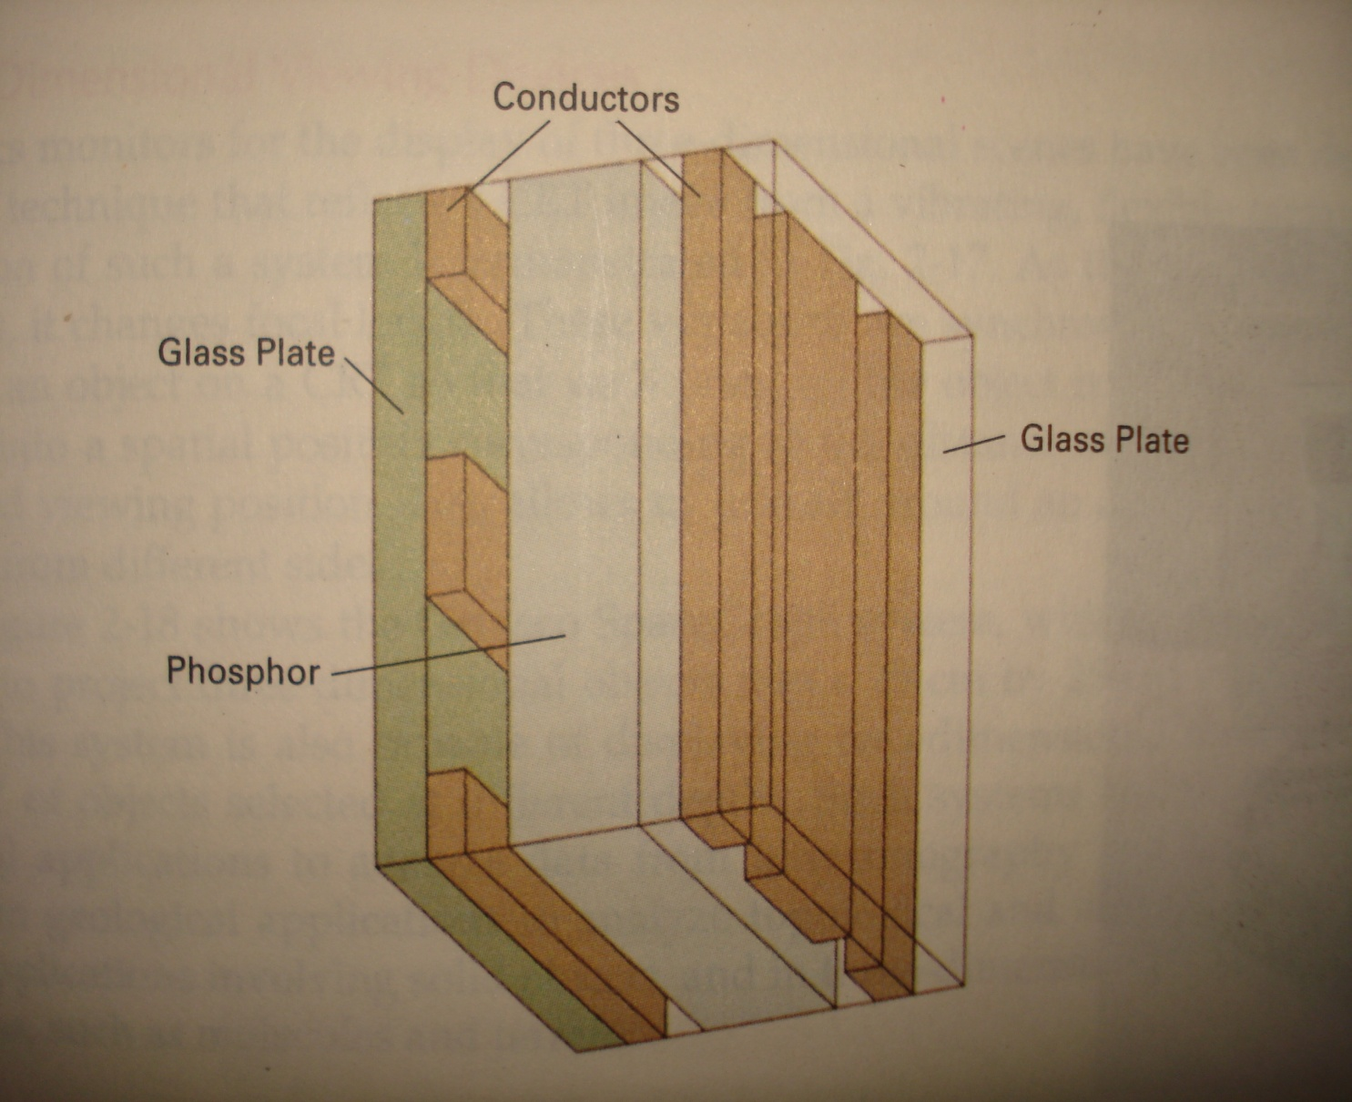
Thin film Electroluminescent display device

Slide 108
Electroluminescent Display
When a sufficient high voltage is applied to a pair of crossing electrodes, the phosphor becomes a conductor in the area of intersection of the two electrodes.
Electric energy is then absorbed by the manganese atoms, which then releases energy as a spot of light.

Slide 109
ADVANTAGES:
Recently blue, red, and green electroluminescent materials have been developed that offer the potential for long life and full color electroluminescent displays.
It has high resolution display.
DISADVANTAGES:
High power consumption.
Expensive and bulky.

Slide 110
Plasma panel Display
It consists of two glass sheets placed face to face and very close to each other.
The region between them is filled with a mixture of neon based gas.
Thin and closely spaced gold electrodes are attached vertically on the inner side of one sheet and horizontally on another sheet
When a sufficiently high voltage is applied the gas dissociates, i.e. electrons are stripped from the atoms. The dissociated gas is called a plasma, hence the name plasma display.
When the electrons recombine, energy is released in the form of photons; and the gas glows .
This glow can be sustained by maintaining a high frequency alternating voltage across the cell.

Slide 111
Plasma panel Display
A cell can be switched on by momentarily increasing the sustaining voltage and switched off by lowering the signal.
The signal amplitude is chosen so correctly , cells that have not been fired will not be affected.

Slide 112
Plasma panel Display
Advantages:
It allows both selective writing and selective erase
It produces a steady image which is free from flicker.
It is less bulky than CRT.
Disadvantages:
It is monochromatic
It has poor resolution
It has complex addressing and wiring requirements

Slide 113
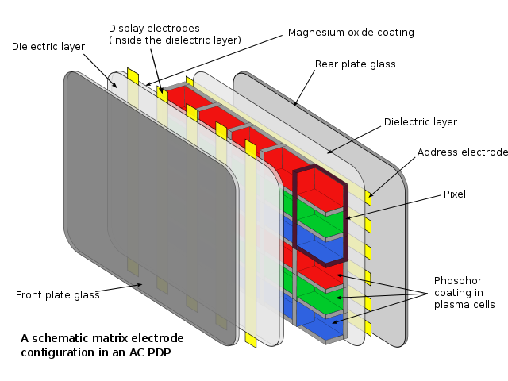

Slide 114
LIQUID CRYSTAL DISPLAY (LCDs)
LCDs are commonly used in small systems, such as calculators, laptop computers. these are the non emissive devices.
The term liquid crystal refers to the fact that these compounds have a crystalline arrangement of molecules, yet they flow like a liquid.
Flat panel displays commonly used nematic (thread like) liquid crystal compounds that tend to keep the long axes of the rod shape molecules aligned.

Slide 115
Two glass plates, each containing a light – polarizer at right angles to the other plate, sandwich the liquid crystal material.
Rows of horizontal transparent conductors are built into one glass plate and columns of vertical conductors are put into the other plate
The intersection of two conductors defines a pixel position.
The polarized light passing through the material is twisted so that it will pass through the opposite polarizer.
The light is then reflected back to the viewer.

Slide 116
To turn off the pixel we apply the voltage to the two intersecting conductors to align the molecules so that the light is not twisted.
This type of flat panel displays is referred to as passive-matrix LCD.
Colors can be displayed by using different materials and by placing a triad of color pixels at each screen loactions.

Slide 117
Another method for construction LCDs is to place a transistor at each pixel location using thin- film transistor technology.
The transistors are used to control the voltage at pixel locations and prevent charge from gradually leaking out of the liquid crystal cells.
These devices are called Active Matrix Displays

Slide 118
construction
LCD is made up of six layers.
The front layer is the first layer is a vertical polarizer.
Second layer with thin grid wire electrode deposited on the surface adjoining the crystals.
Third is a thin liquid crystal layer .
Fourth is a layer with horizontal grid wires on the surface.
Fifth layer is the horizontal polarizer .
Last one is reflector.

Slide 119
.
.
Horizontal polarizer
Liquid crystal layer
Vertical polarizer
Reflector
Horizontal grid wire
Vertical grid wire
.
.
.
Matrix form
Pixel

Slide 120
LASER SCAN DISPLAY
Laser scan display is one of the few high resolution large screen display devices.
It has been used in displaying maps, high quality text and elaborate ckt diagrams.
In laser scan display , a laser is deflected by a pair of mirrors so that it traces out the desired image on a sheet of photo chromic film. The material usually transparent but light from the laser leaves a dark trace on it.
A light projection system is used to project light onto a large screen. The image thus deposited on the film.
To produce a fresh image the display simply winds the role of film to bring a blank region under the laser, the mirrors deflecting the laser are extremely small and are controlled by the electrical signals received from the display controller.

Slide 121
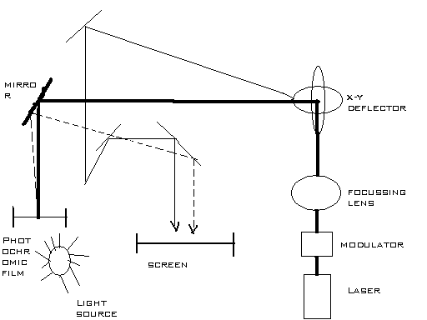

Slide 122
Interlacing
Each frame has two fields, each containing half the picture.
Fields are interlaced and interwoven.
Fields are presented alternately every other 1/60th of a second.
One field contain odd lines(1,3,5,7,…….)
One field contain even lines(0,2,4,6,…….)
Interlacing scan lines on a raster scan display.
First all points on even numbered (solid) scan lines are displayed, then all points along the odd numbers (dashed) lines are displayed.

Slide 123
0
1
2
3
4
5
6
7
8
9
10
11

Slide 124
School of Computing Science and Engineering
Course Code : BCSE3069 Course Name: Computer Graphics
Thank you!
Name of the Faculty: Ashish Kumar Srivastava Program Name: B.Tech

